Slide 1

Netflix Dashboard
Created by : Yash Gode

Slide 2
Project Description
This dataset consists of listings of all the movies and tv shows available on Netflix, along with details such as - cast, directors, ratings, release year, duration, etc.
Tools Used : Tableau Desktop
Dataset Link : Netflix Dashboard

Slide 3
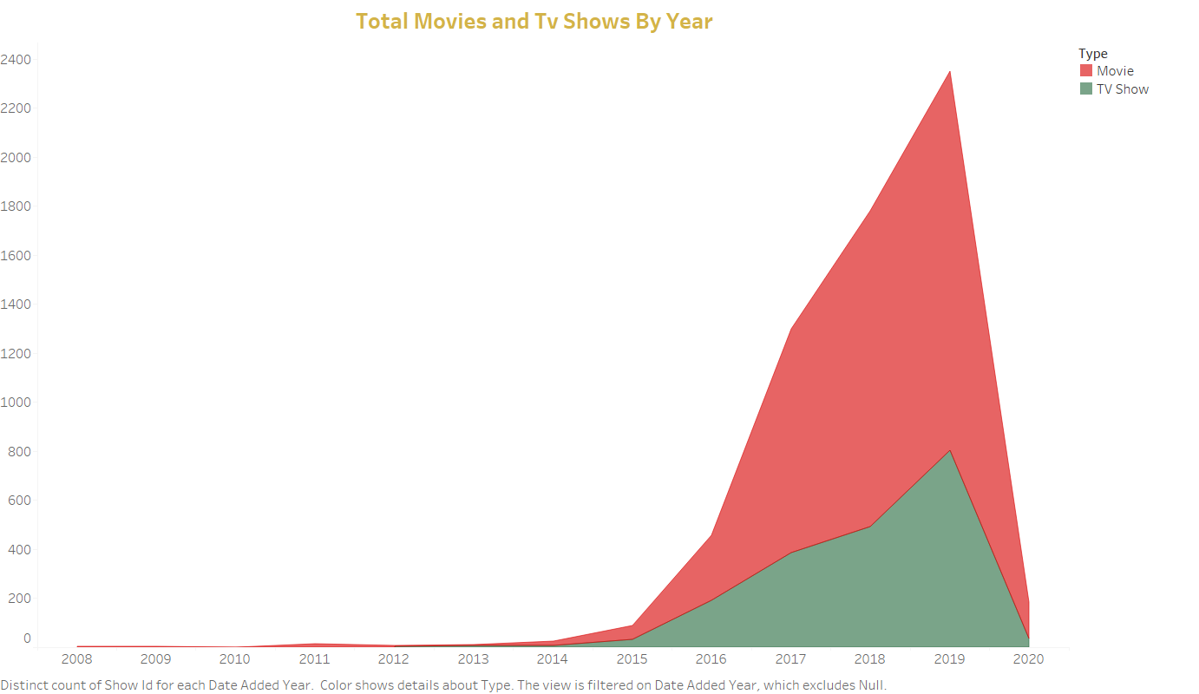

Slide 4
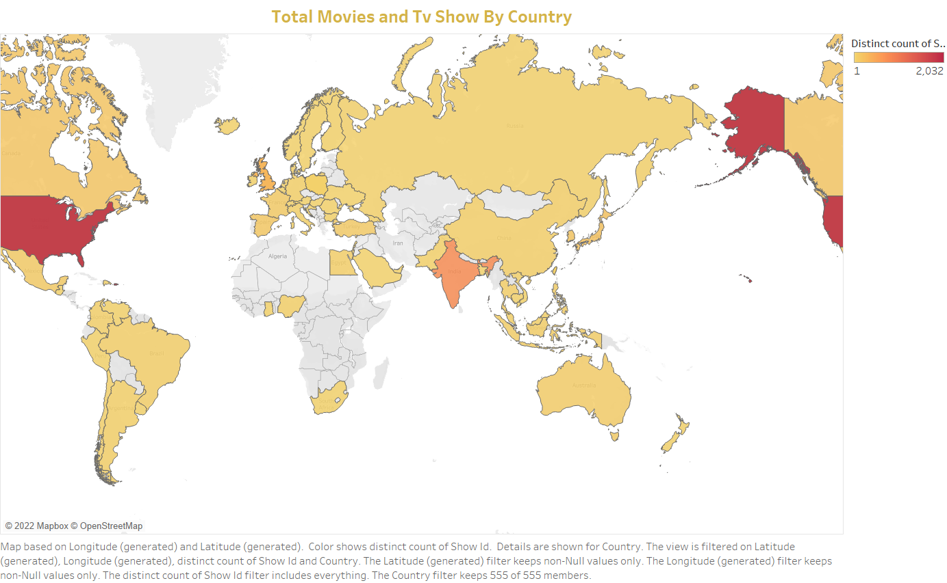

Slide 5
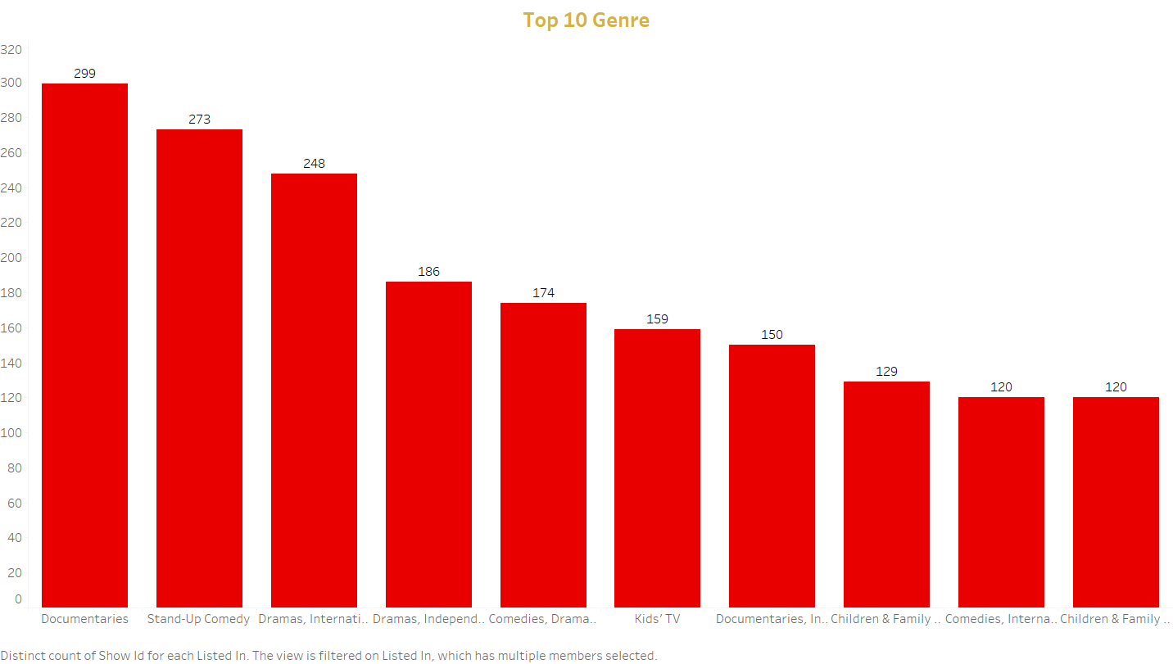

Slide 6
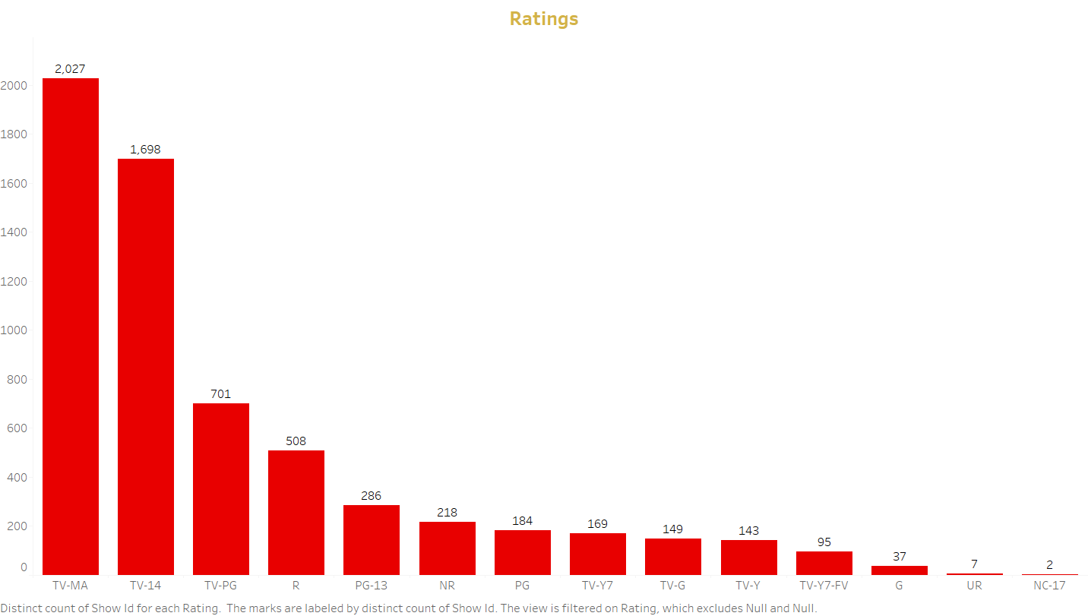

Slide 7
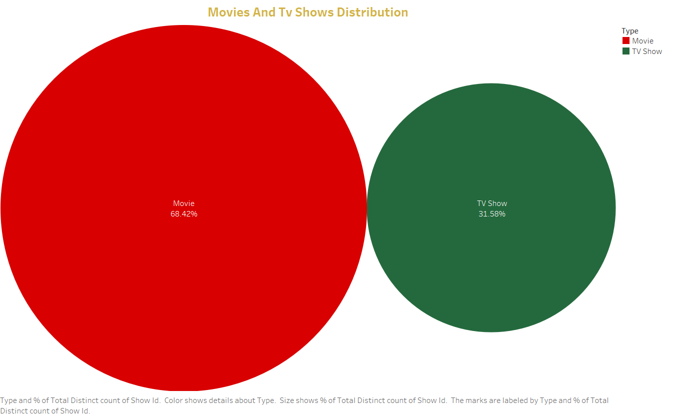

Slide 8
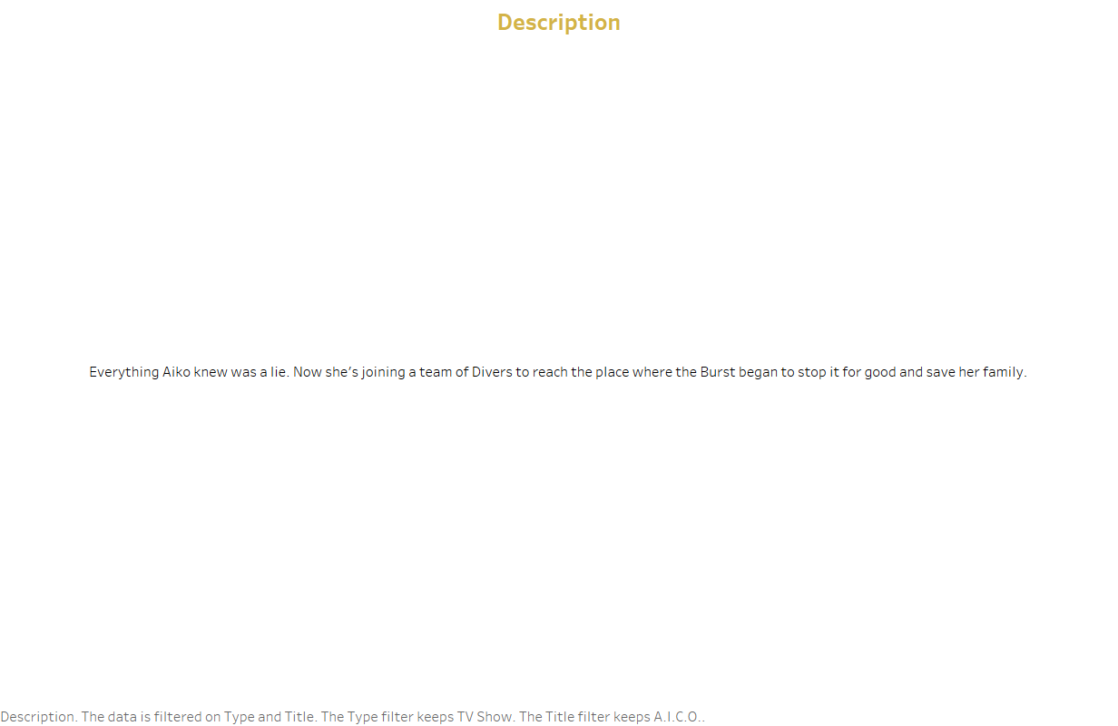

Slide 9
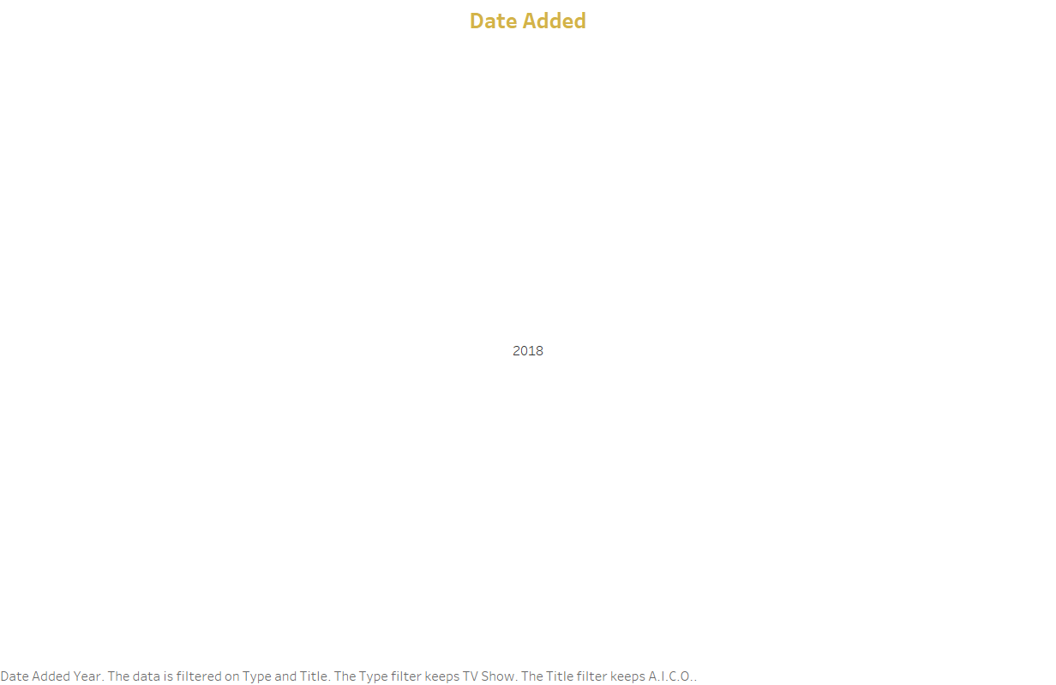

Slide 10
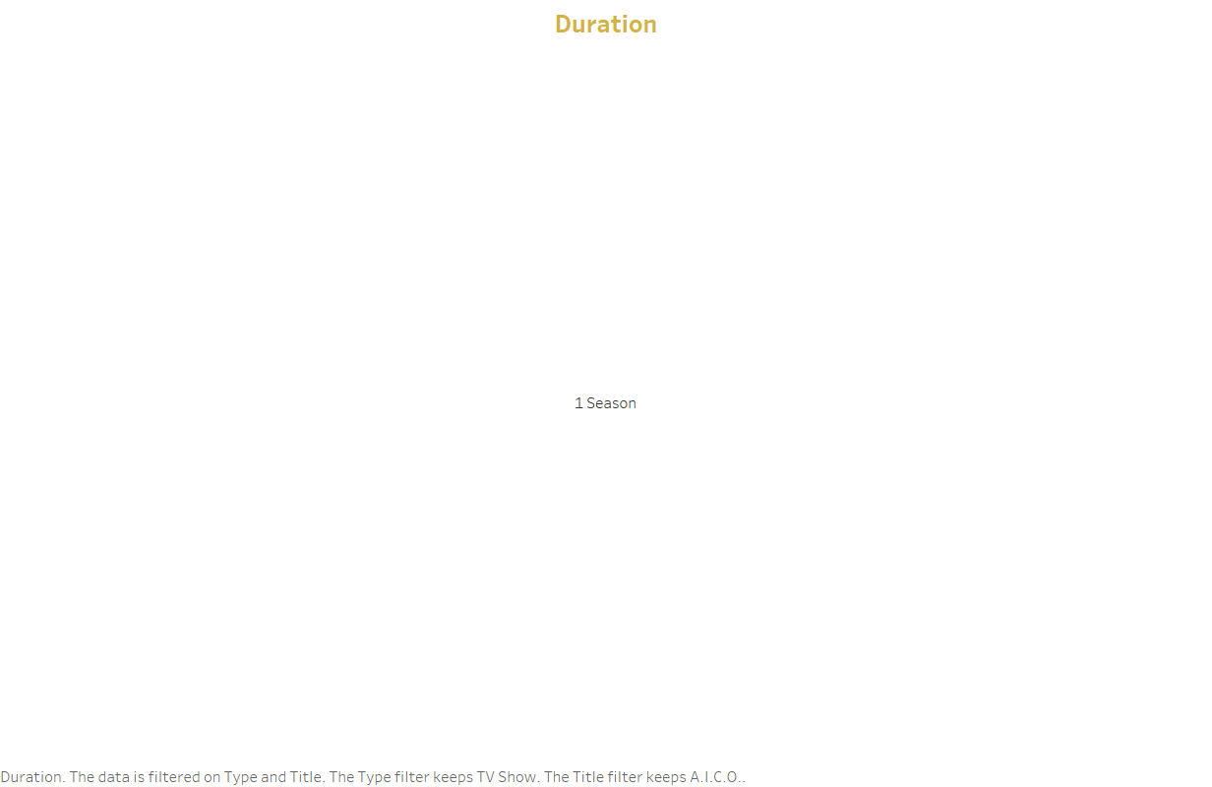

Slide 11
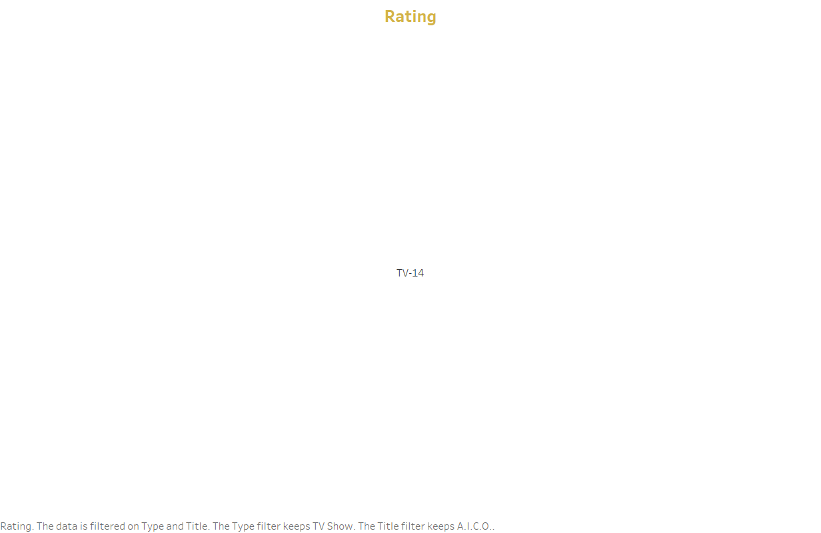

Slide 12
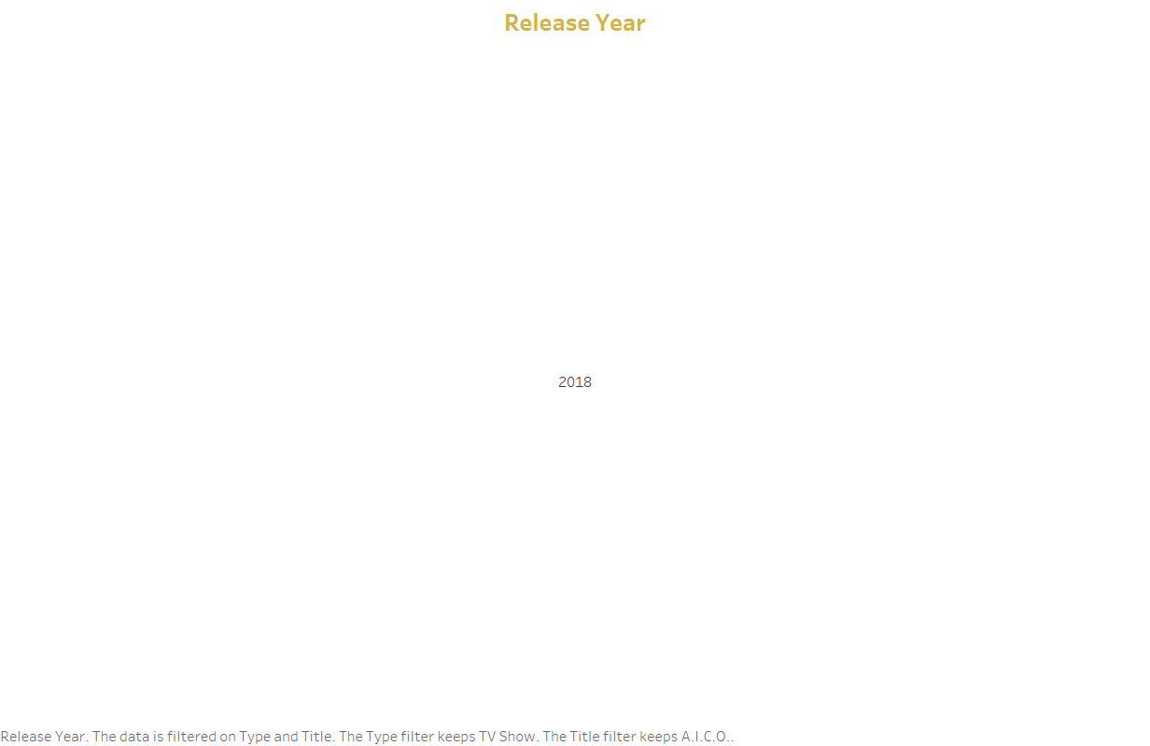

Slide 13
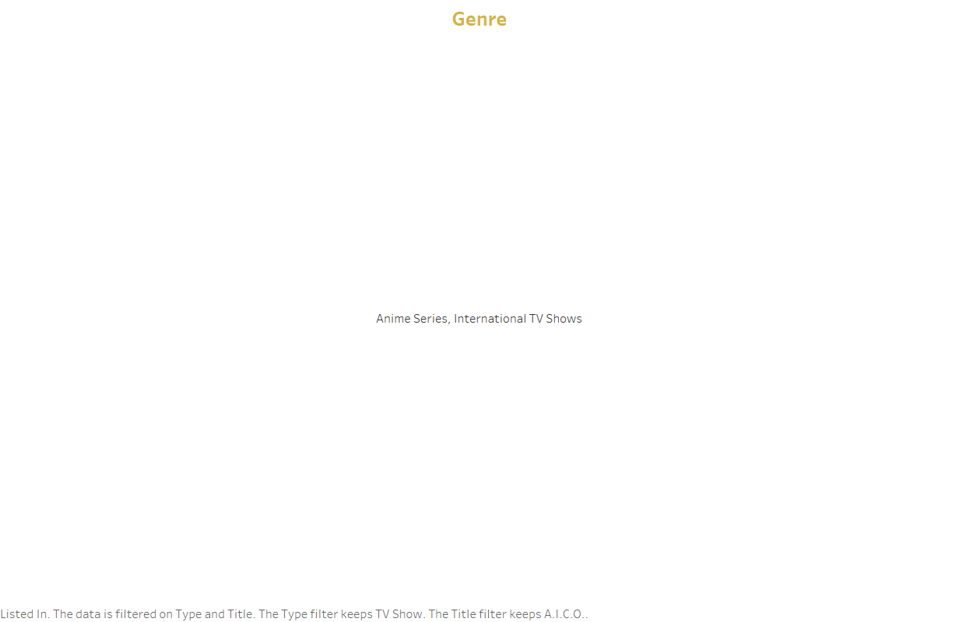

Slide 14
